Slide 1
HISLAB_112碩_讀書會
HW 1 – Regression
Reporter:余承儒

Slide 2
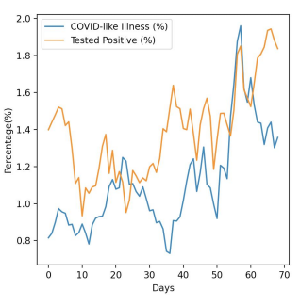
課程目標
COVID-19 Cases Prediction
藍線-有類似covid-19的症狀的比例
橘線-陽性的比例

Slide 3
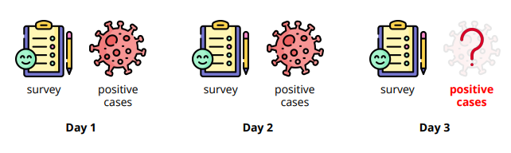
有過去三天的資料，要算出第三天測出陽性比例

Slide 4
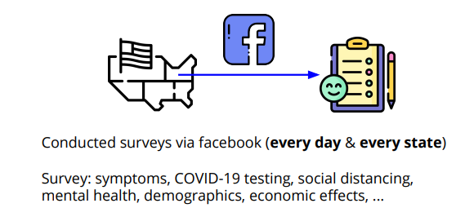
Data

Slide 5
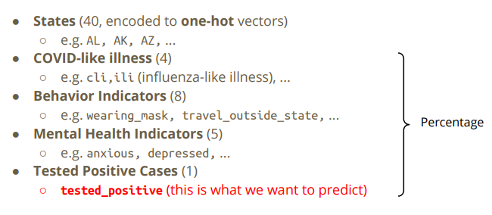
Data

Slide 6
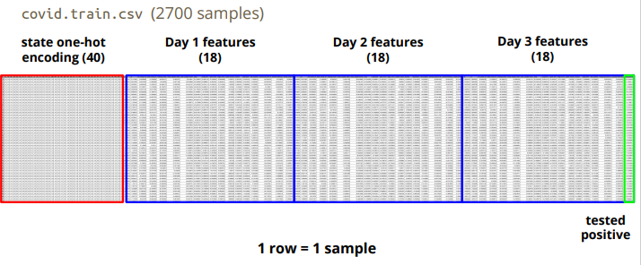
Data-Training

Slide 7
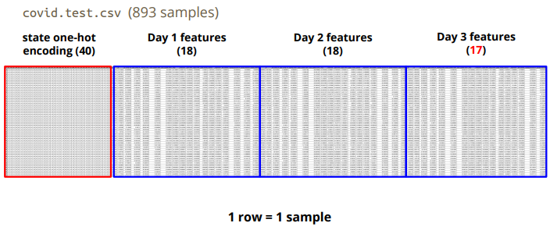
Data-Testing

Slide 8
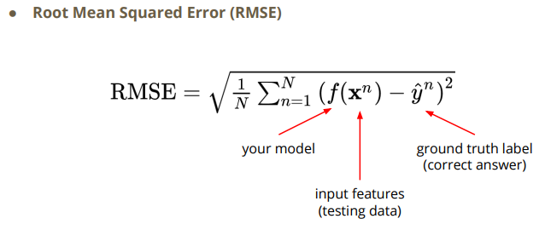
RMSE

Slide 9
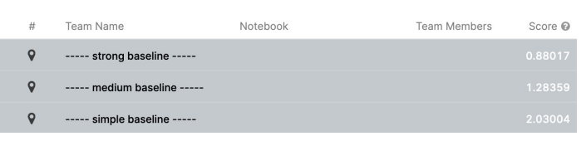
kaggle

Slide 10
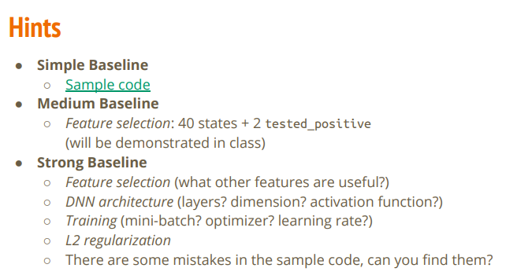
Hints

Slide 11
Sample baseline
Run sample Code

Slide 12
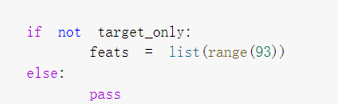
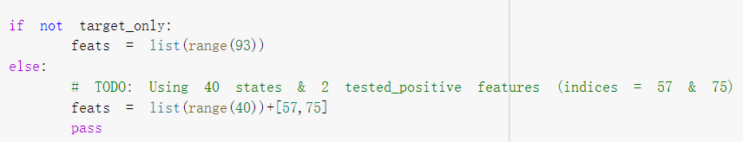
Medium baseline
修改DataSet裡的程式碼，選擇更好的feature做訓練

Slide 13
(57)
Test_positive
(75)
Test_positive

Slide 14
Kaggle

Slide 15
Strong baseline
Feature selection
DNN architecture (layers? dimension? activation function?)
Training (mini-batch? optimizer? learning rate?)
L2 regularization
There are some mistakes in the sample code, can you find them?

Slide 16
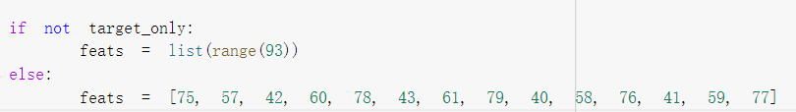
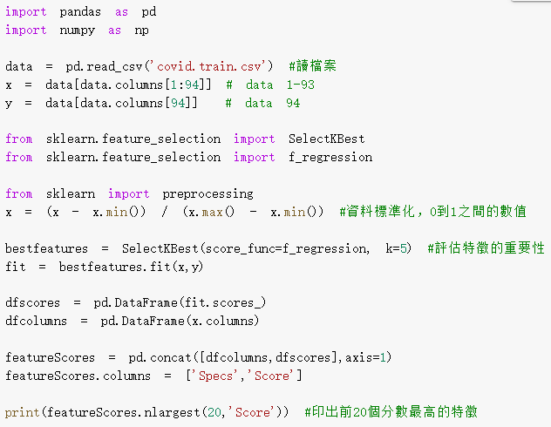
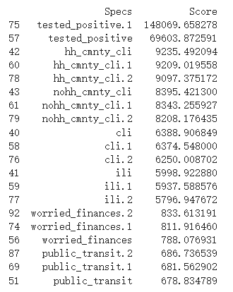
Feature selection

Slide 17
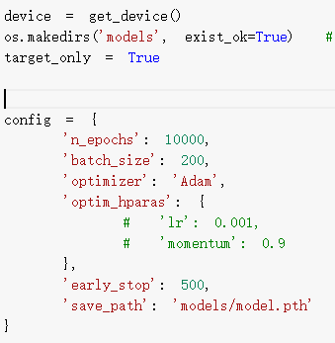
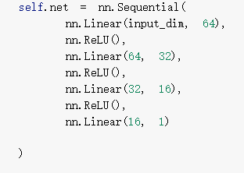

Slide 18
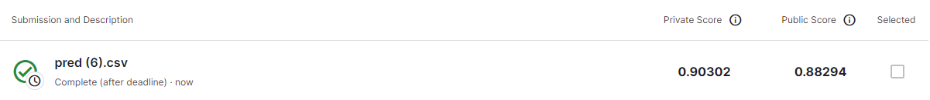
Kaggle

